Slide 1



Debiasing Property Appraisal AVMs: Protecting Civil Rights & Advancing Tech Equity
Team 4

Slide 2

Background: Key Points
AI is a civil rights issue! The neutralizing language of algorithmic fairness focuses attention on the tech, but civil rights invokes the harm to human communities and a tradition of powerful change.
Percentage magnitude of error higher in majority-Black neighborhoods.
Appraisal can calcify past patterns of discrimination.
Closely tailoring comparables advantages sellers in majority-white neighborhoods.
White purchasers benefit in majority-Black communities, not vice versa.
AVM lag in detecting property value increase due to gentrification.
Below-market appraisals more common in Black and Latino markets.
AVM bias < human bias.
Collateral benefits of AVM-first approach: democratizing and diversifying appraisal industry.
Both intent and impact are actionable; impact is more relevant to AVM challenges.
Notes:
For in person appraisals: 15.4% of majority-latino neighborhoods appraisal = below contract price, 12.5% majority-black, and 7.4% majority white

Slide 3

Problem #1: Test an AVM for racially biased outcomes.
Given:
log-error data for 2016 CA home appraisals calculated by automated valuation model (AVM)
census tract aggregate demographic data
Analyze:
Does the AVM generate error that disproportionately harms communities of color?
Magnitude and direction of any detected bias with respect to protected classes
Strategy:
Data preprocessing
Exploratory data analysis and statistical testing
Build a classifier to mimic the AVM
Predict the log errors within protected and control group for 2017 test data
Evaluate classifier performance
Rank importance and relative magnitude of model’s input features

Slide 4
Preprocessing
Preprocess
Join
Analyze
Analysis of missingness
Address null values
Transform categorical variables
Minimize cardinality
Dimensionality reduction
Joining
Property specs with training and testing data
Census demographics with preprocessed data
… but beware data leakage!
Notes:
Preprocessing data:
Data we were given has many missing values → what to do?
Separating processing into 3 sections:
Dropping data
entire column
Can be for nonrelevance or for too little data
entire rows
most value is there, but few rows missing
fill categorical data
either true false, or id’s
fill numerical data
replace with zero’s i.e. basement square footage if no basement is present

Slide 5
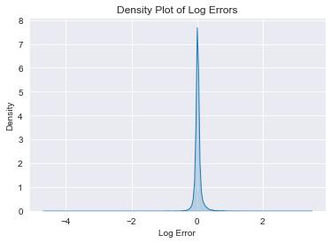
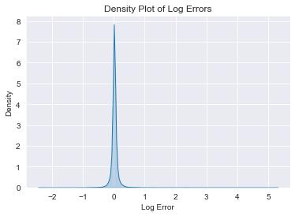
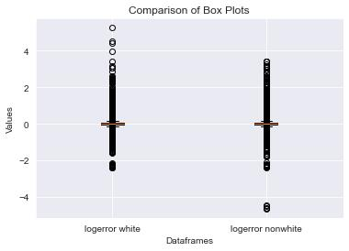
Exploratory Data Analysis
Properties in communities of color
Properties in majority-white communities
Skewness for majority-white: 4.774
Skewness for communities of color: 1.364
Majority-white has much more extreme right-tailed distribution. Values asymmetric about the mean with a higher proportion of scores above than below the mean.

Slide 6
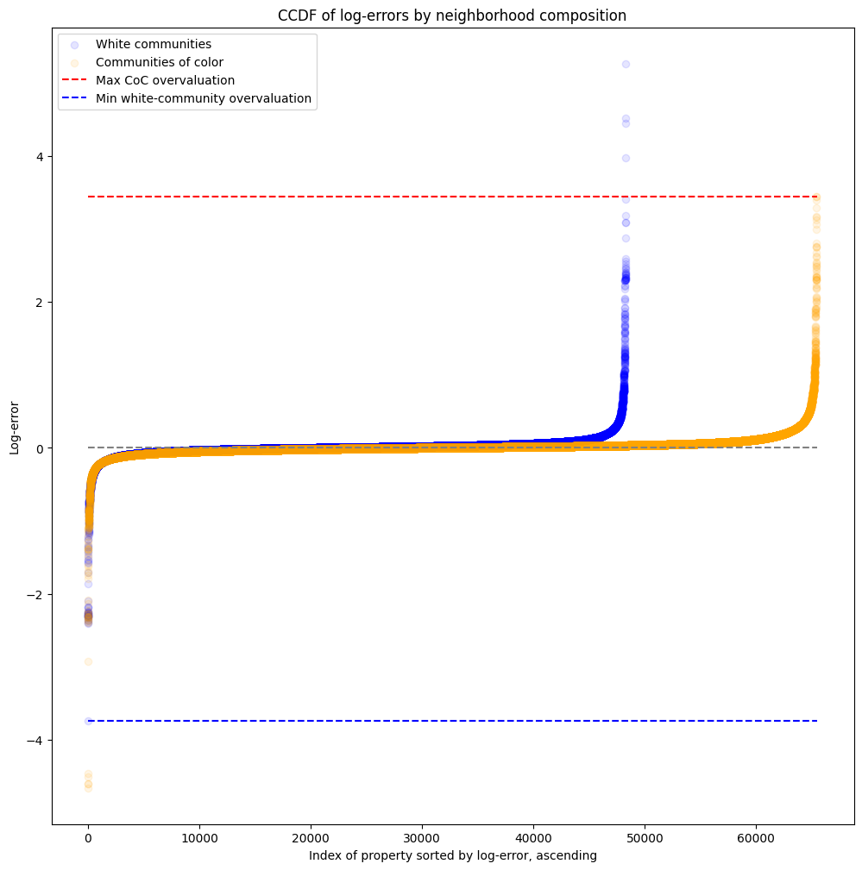
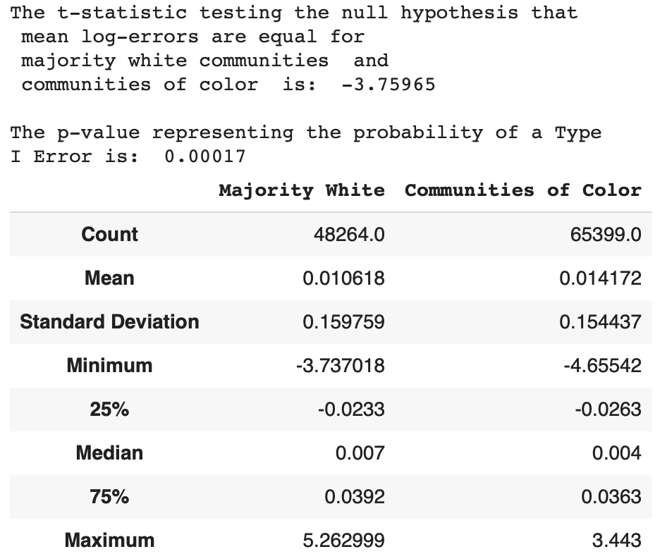
Problem #2: Quantify the size of the bias.
Median log-error favors properties sold in white neighborhoods.
* p-value = 0.00017 for $H_{O}:{\overline{x}}_{w}={\overline{x}}_{coc}$, but fails independence test
(but that’s also the point!)

Slide 7
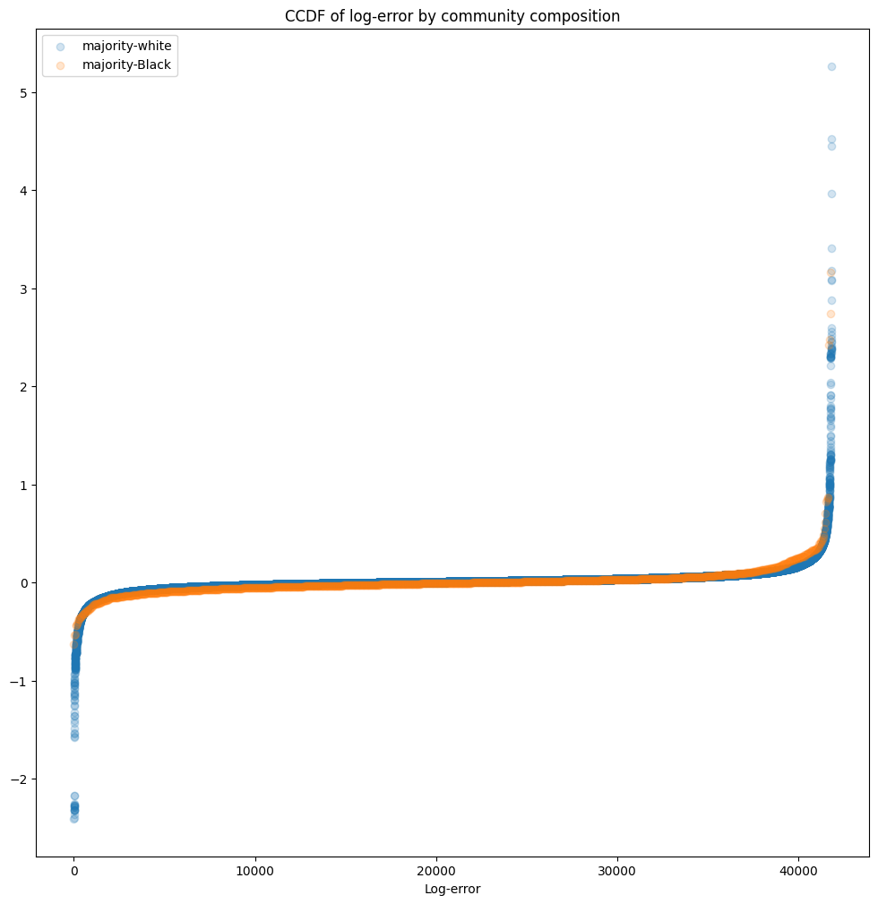
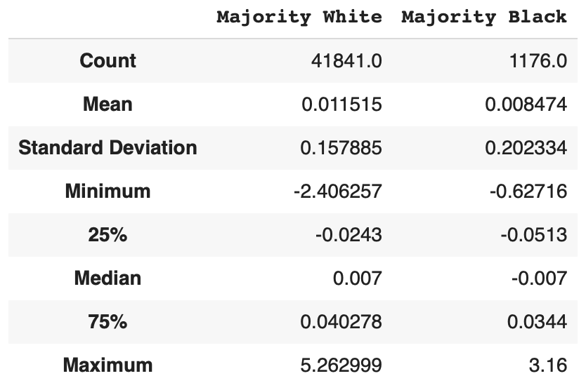
Problem #2: Quantify the size of the bias.
Median log-error favors properties sold in white neighborhoods.
* p-value = 0.609 for $H_{O}:{\overline{x}}_{w}={\overline{x}}_{coc}$
not statistically significant

Slide 8
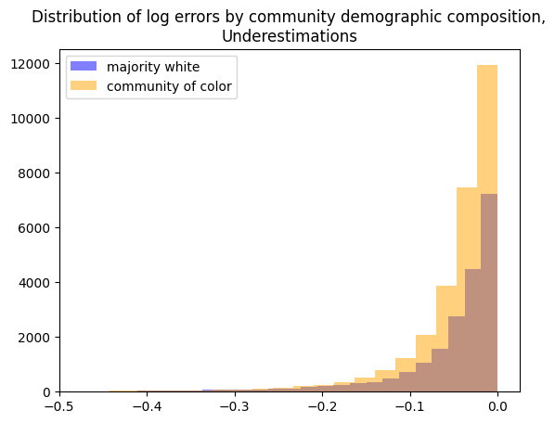
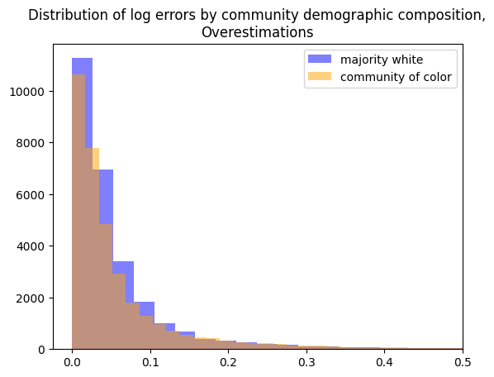
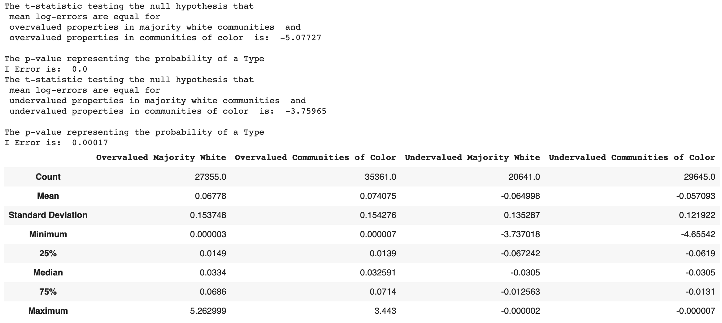
What does bias look like?
Median log-error greater for overappraised properties in majority-
white neighborhoods, equal for undervalued properties.
* p-value = 0.00000 for $H_{O}:{\overline{x}}_{w}={\overline{x}}_{coc}$ both for undervalued and overvalued

Slide 9
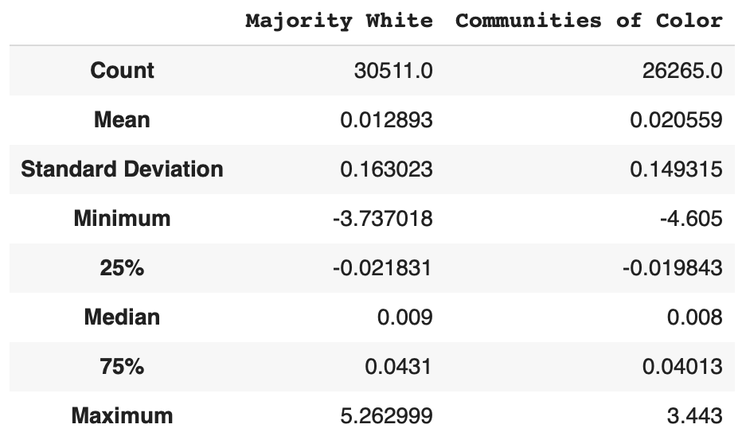
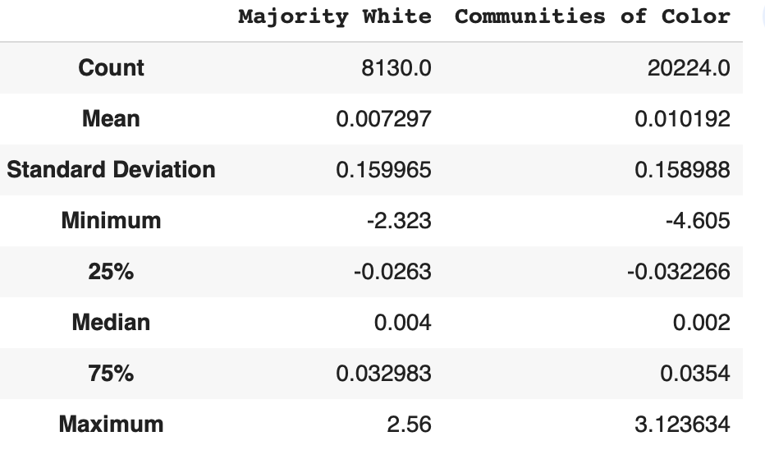
Does appraisal differ by home size across communities?
Top percentile
Dataset is noisy, so we segmented the market into quartiles by square footage.
For the largest houses, median log-error overvalues properties in majority white houses more than in communities of color.
For smallest houses, houses in communities of color are more undervalued.
Bottom percentile
… see caveats: sample size sensitivity,
lack of data on buyer/seller rate

Slide 10
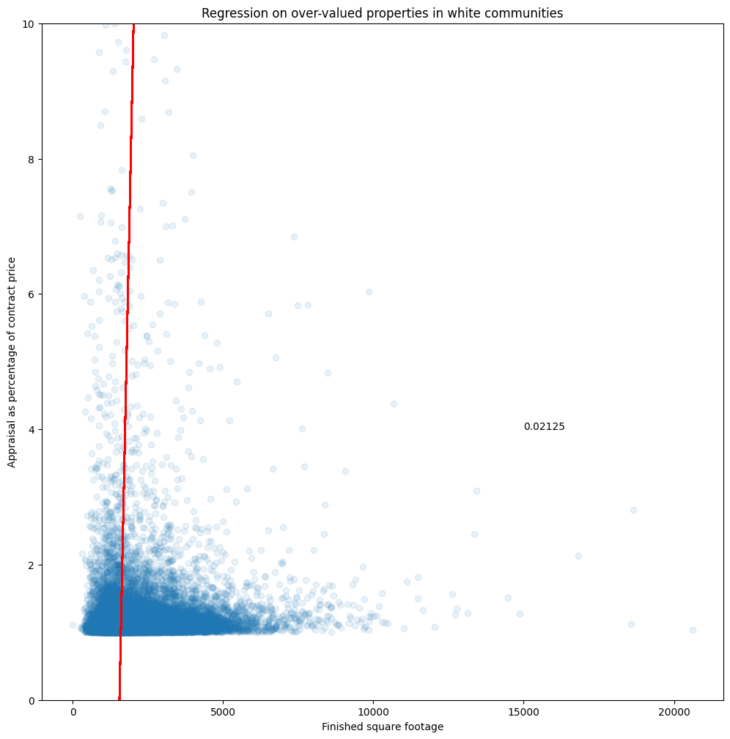
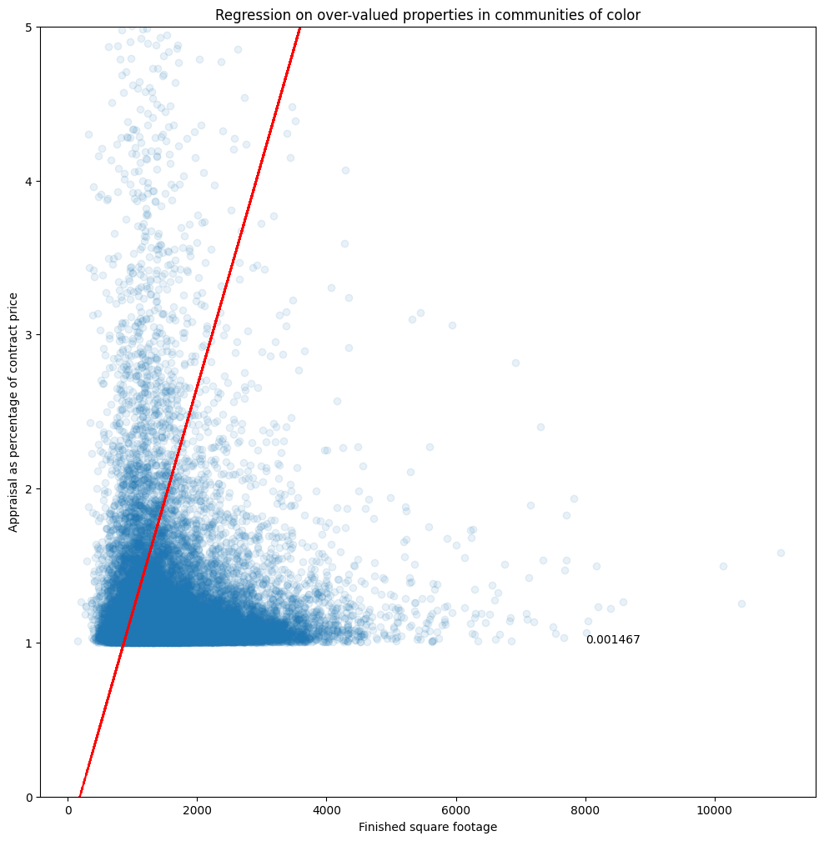


Error Scaling
$${10}^{log\frac{appraisal}{contract}}$$
$$=\frac{appraisal}{contract}$$
Exponentiated the appraisal error score to get a measure of appraisal as a proportion of contract price.
+ 2.1% increase in appraisal as percent of contract price per finished square foot for overvalued white communities.
+ 0.15% increase in appraisal as percent of contract price per finished square foot for overvalued communities of color.

Slide 11

Model selection
CatBoost – Open Source Gradient Boosting
Gradient Boosting combines weak models with strong ones for competitive modelling
applies target encoding with random permutation to handle categorical features
very efficient for high cardinality columns creates just a new feature to account for the category encoding
Uses ordered boosting, a permutation-driven approach to train the model on a subset of data while calculating residuals on another subset prevents target leakage and overfitting
Building the model
Separate out categorical features vs. Numerical
Select parameters: 150 iterations (max trees), RMSE (training metric), 6 tree depth, .21 learning rate (default .1)
Grid Search for parameter optimization, results by feature importance
Evaluation using RMSE, best performing model performed had a RMSE of ~0.15
Notes:
Pros of Catboost:
Handling of Categorical Variables: CatBoost natively handles categorical features, which means you don't need to preprocess them separately. It automatically handles the encoding of categorical variables and incorporates the information during training, resulting in better model performance.
Performance: CatBoost often delivers competitive performance compared to other gradient boosting algorithms, especially when dealing with datasets containing categorical variables. It has built-in techniques to handle high-cardinality categorical variables and can handle missing values effectively.
Out-of-the-Box Features: CatBoost provides several useful features, such as handling of numerical and categorical features, handling of missing values, built-in cross-validation, and early stopping. It also has built-in tools for model interpretation, feature importance, and hyperparameter tuning.
Robustness to Overfitting: CatBoost includes techniques to prevent overfitting, such as a built-in regularization mechanism and the ability to control the depth of trees. It also implements a per-iteration feature to shrink trees, which can improve the model's generalization ability.

Slide 12
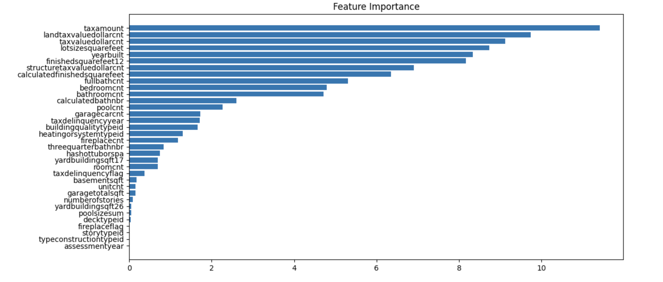
Problem #3: Identify feature importance.
… recall that feature importance cannot be considered independently of model performance.

Slide 13
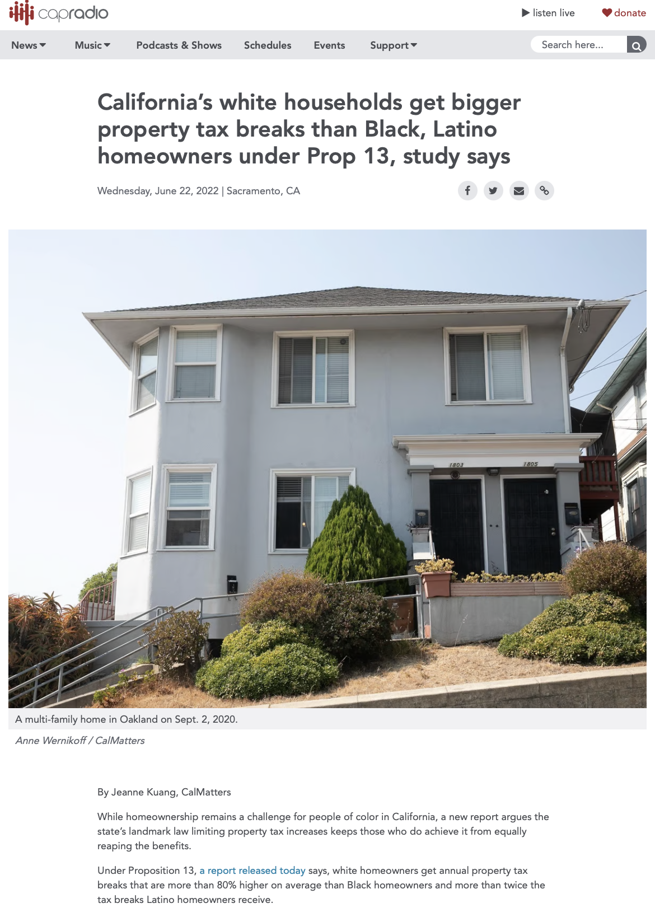
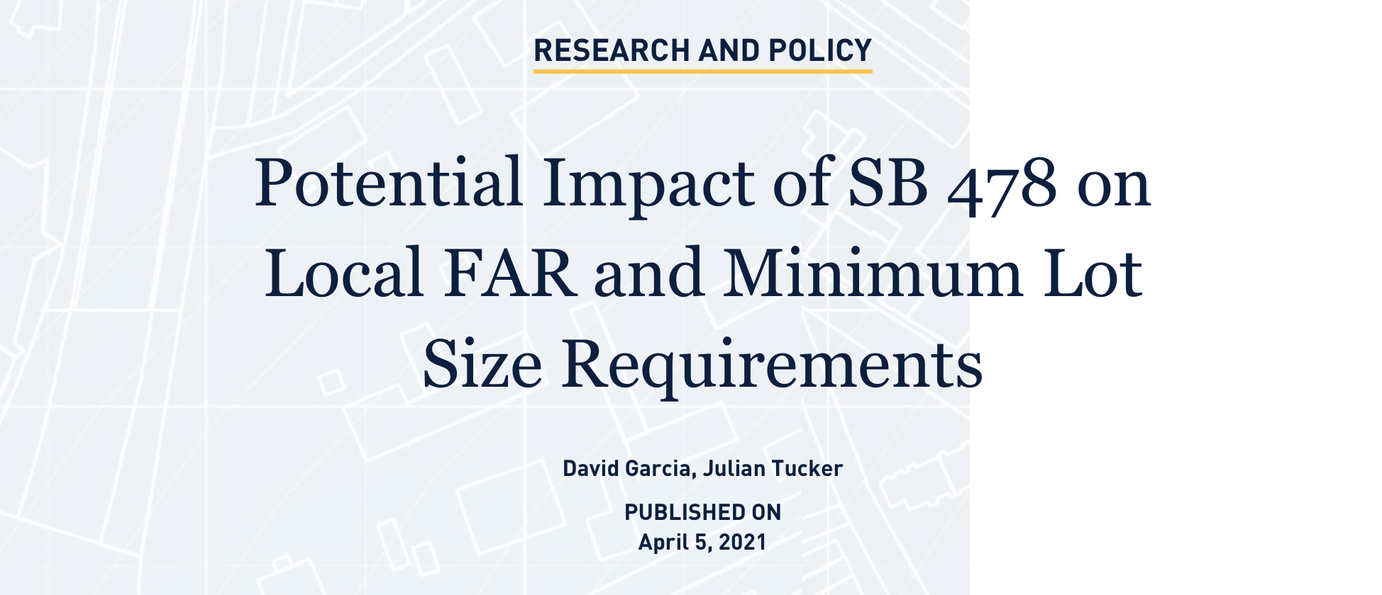
Problem #4: Describe potential societal harm.
Disparity in wealth generation through home sales due to disparate impact of property tax reform
Legacy effect of discriminatory zoning
Impact on appraisal of older home ownership by Black communities
Notes:
In California, property taxation is a system that continues to have racially disparate outcomes to the detriment of the Black community. Market value outpaces assessed values, and so model reliance on assessed tax value will disadvantage Black sellers in a gentrifying market, even as Berkeley researchers charge that statewide tax regulation Proposition 13 has resulted in tax savings to white households that are 80% higher than savings for Black and Latino households. This means that two houses that sell for the same amount will result in a greater net profit to a white seller than to a Black seller even the houses were assessed at the same amount in a given year. Similarly, lot size and year built can contribute to greater error in communities of color. The lot size of a property for sale is often driven by minimum lot size zoning requirements that were established at the time of the property’s development. Such zoning requirements were often established historically with an explicit goal of excluding low-income people and people of color and protecting property value. Year built is, as we’ve seen in our presentations here this weekend, essentially a signal of property age, which correlates with neighborhood demographics, with people of color often owning older properties. Finally, an AVM reliant on tax assessments of land, parcel, or lot size will likely disadvantage sellers of mobile and modular homes, who often do not own the land on which their home is situated.
appraisal below contract price ⇒ higher required down payment, can cause sale to fall through ⇒ downward price renegotiation, helps buyer but reduces seller’s gains
low valuation ⇒ reduced cash-out for homeowner and affecting refinance interest rate and mortgage insurance premiums
undervaluation can compound bc similar properties all valued lower
eliminating racial disparities in rate of homeownership would shrink wealth by black-white by 31% and latino-white by 28%

Slide 14
Problem #5: Mitigate bias, retain AVM performance.
Disentangle property appraisal from tax assessments
Tune AVM to increase reliance on construction, size, and other features of value to homeowners
Incentivize more complete data collection and reporting to drive appraisals based on a fuller picture, stronger multivariate analysis
Build stronger real-time detection algorithm to boost sales price for sellers in gentrifying majority-Black neighborhoods
Annual audit of semi-random sample of AVM appraisals of homes reflecting community demographics
Overseen by multidisciplinary Advisory Committee: community members, human appraisers, industry experts

Slide 15


Broader Policy Recommendations
Nonprofit, nonpartisan industry oversight, accreditation, and arbitration partnerships to provide alternatives to costly litigation before an underinformed judiciary
More project-based learning and community-building events to support the BIPOC tech/AI community
Public education campaigns to raise awareness of AVM risk and available remedies
Make public funding available to increase risk tolerance for lenders to counterbalance AVM bias
Fund small community businesses, especially in property rehab, to minimize default and distressed-property sales

